Slide 1
Predictive Market Analysis
In Ames, Iowa
Nicholas Dinis

Slide 2
Introduction
Data Scientist based in New Jersey
Licensed Real Estate Agent
Lean Six Sigma Green Belt
Real Estate Investing Experience

Slide 3
Data Cleaning
The raw data had roughly 70 features with quite a few categorical sections.
First, I OneHotEncoded the categorical data. This brought us to about 300 features.
Last, I used a KNN Imputer to fill in our missing values.

Slide 4
Data Modelling
With the cleaned data I used a filter to remove any data that doesn't have a strong positive or negative correlation with the data.
This brought us to roughly 30 features which I ran through multiple pipelines, simple to complex.
Out of about 900 predictions my models total error was about 25,000, roughly 1.5% off per prediction

Slide 5
Market Insights
After analyzing over 2,000 Real Estate Transactions we found the following features have a strong effect on the Sales Price;
Overall Quality
Garage Area
Total Basement sqft
First Floor sqft
Year Remod/Add

Slide 6
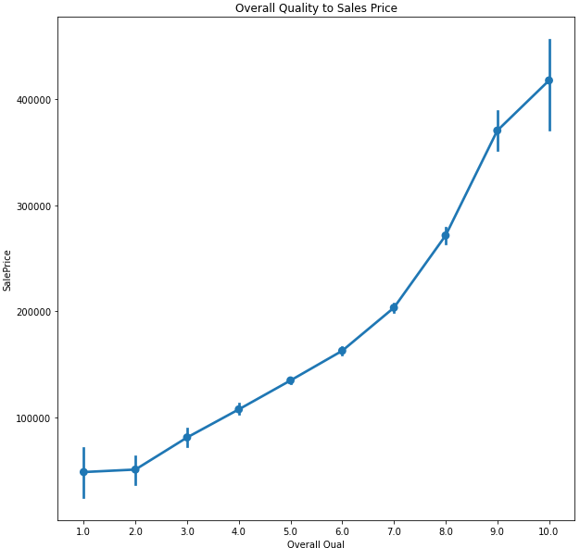
Overall Quality to Sales Price
My first recommendation,
clean the property.
Updated floors, new
paint, appliances and
an exterior power-wash
can go a long way when
someone first lays eyes
on a property.

Slide 7
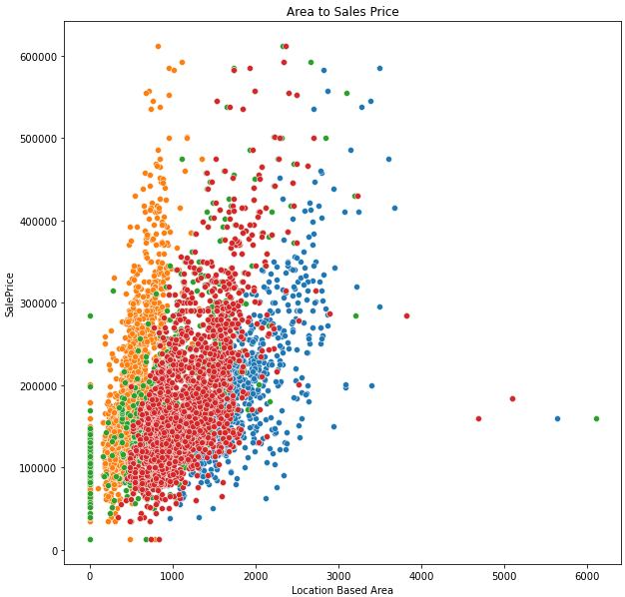
Area to Sales Price
My next recommendation,
maximize livable area.
If you can afford to add
onto an existing home
this will be one of the
best ways to add value
to the property.

Slide 8
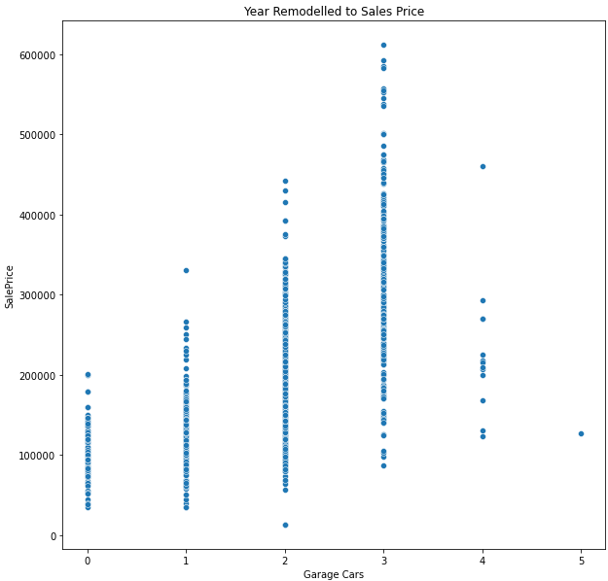
Garage to Sales Price
Final recommendation,
adding a garage.
We see the greatest
increase near 2 to 3 car
capacity garages.
The age of the garage also
has a positive correlation
to sale price.

Slide 9
Conclusion
To maximize profits on your real estate transactions in Ames, start with the top 3 contributors.
Quality, Quality, Quality!
Add to the square footage.
Add a garage/off road parking

